Slide 1
ROAD TO ROCK
Classical Rock Music Trivia Game

Slide 2
The rules
Three different stages of varying difficulty
Varies in difficulty by popularity of the songs when they were released
Players must GUESS ARTIST NAMES of each song
10 songs each stage
3 strikes allowed
Players have to answer 8 questions or more correctly in order to win the stage
10 seconds of playtime for each song

Slide 3
Some mechanics
The songs are constantly shuffled, so there’s no particular order to the game
Can be easily swapped out in future with different songs
Answers can be lowercase or uppercase or a mix, functions are capable of taking in both
Players can also choose to omit the word ‘the’ such as ‘the rolling stones’ or ‘rolling stones’
Both answers will work!

Slide 4
Issues
Figuring out how to work with video backgrounds and audio content
Making site cross-browser compatible. Tested on chrome and safari
Making it suitable for mobile/tablet screens
Had to completely readjust the css and menus
Removed video backgrounds because most devices are not capable of playing them

Slide 5


Landing Page Inspiration

Slide 6
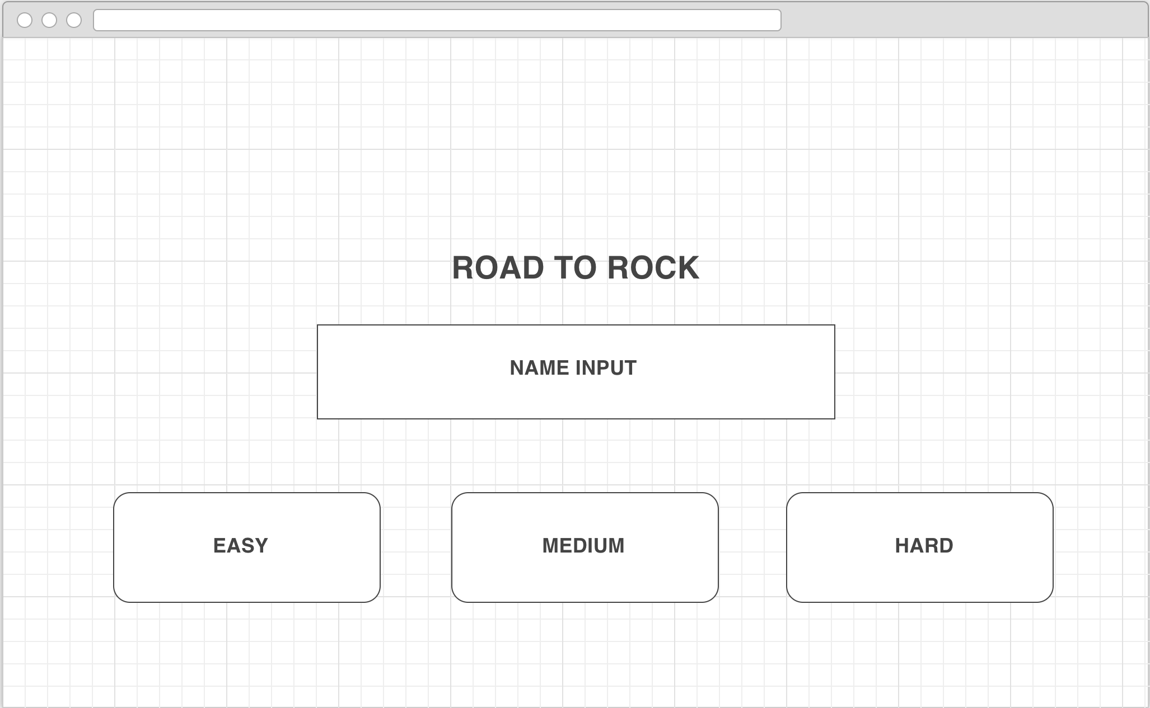
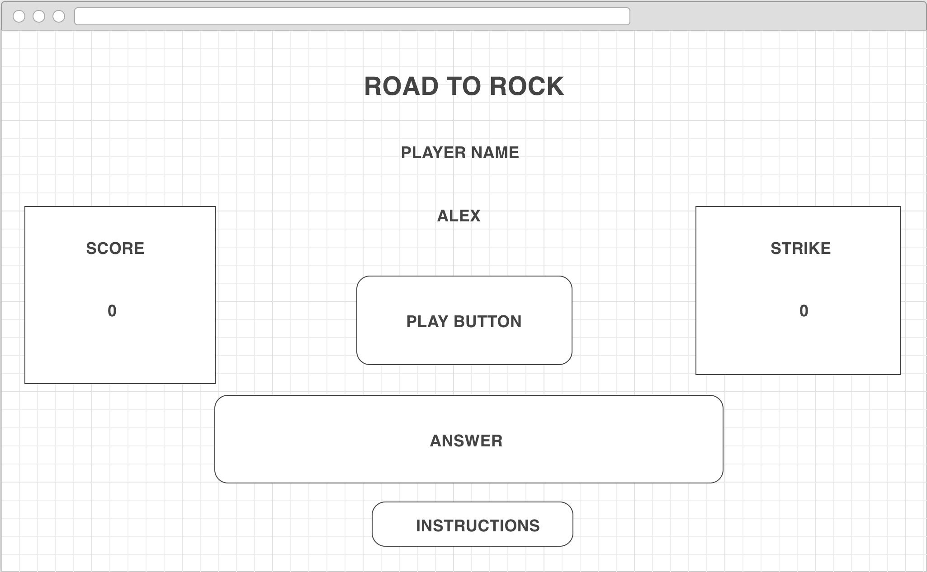
PROPOSED WIREFRAMES
LANDING PAGE
GAME PAGE

Slide 7
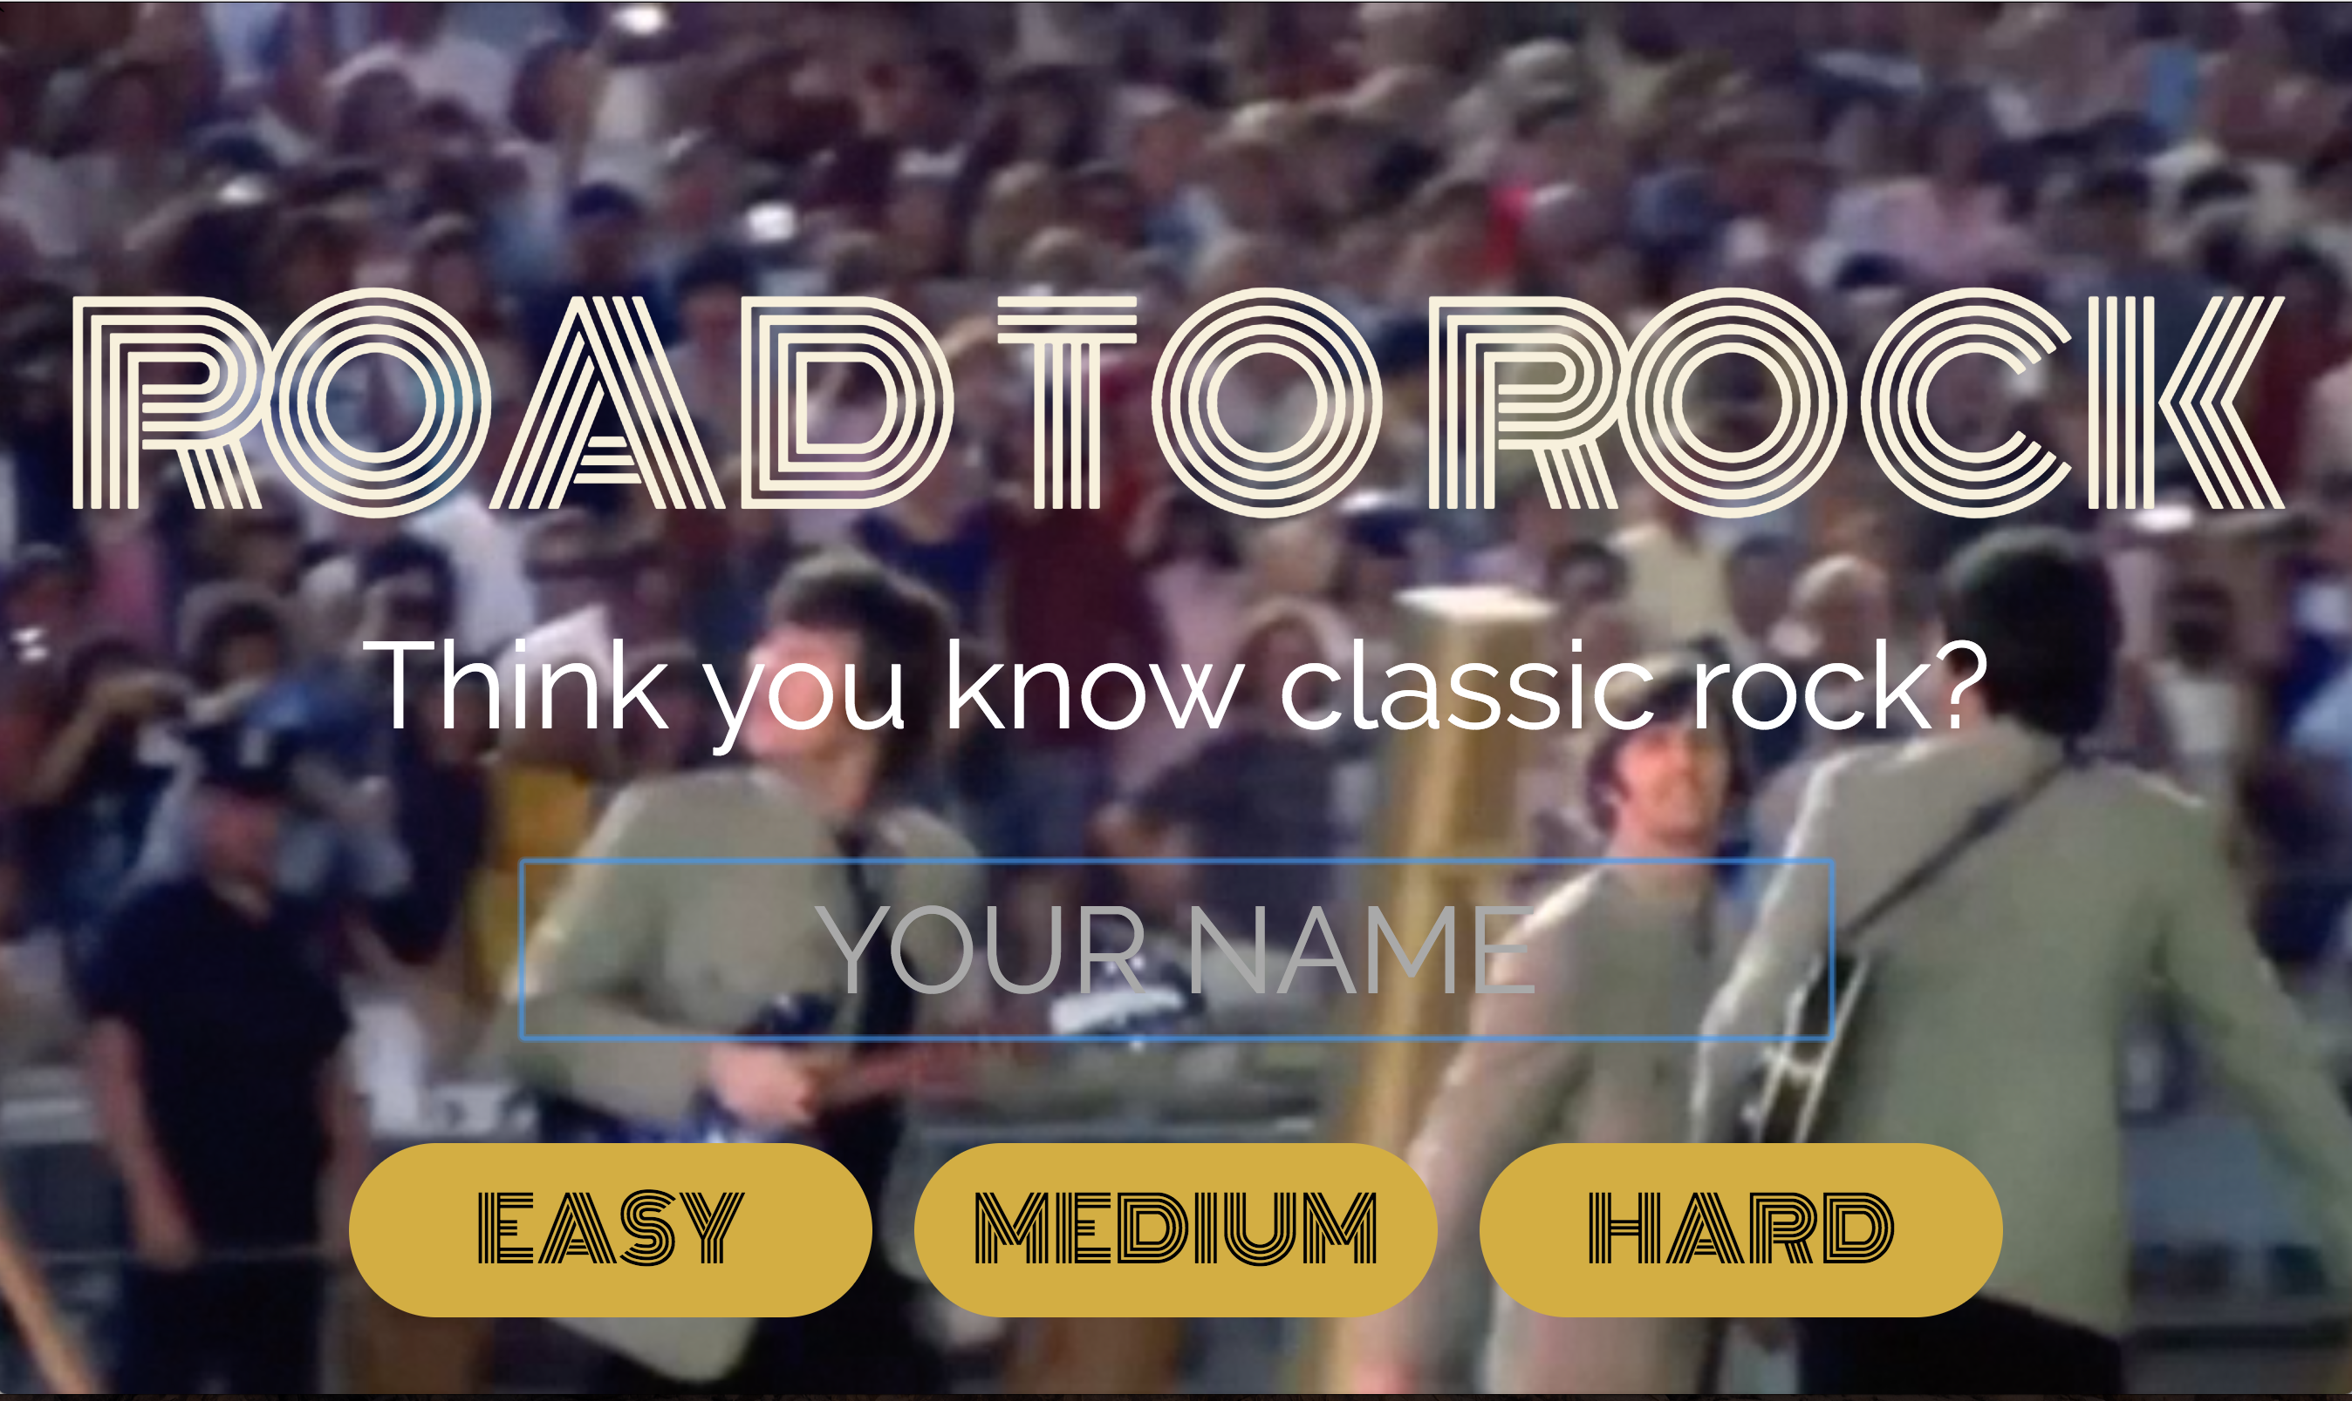
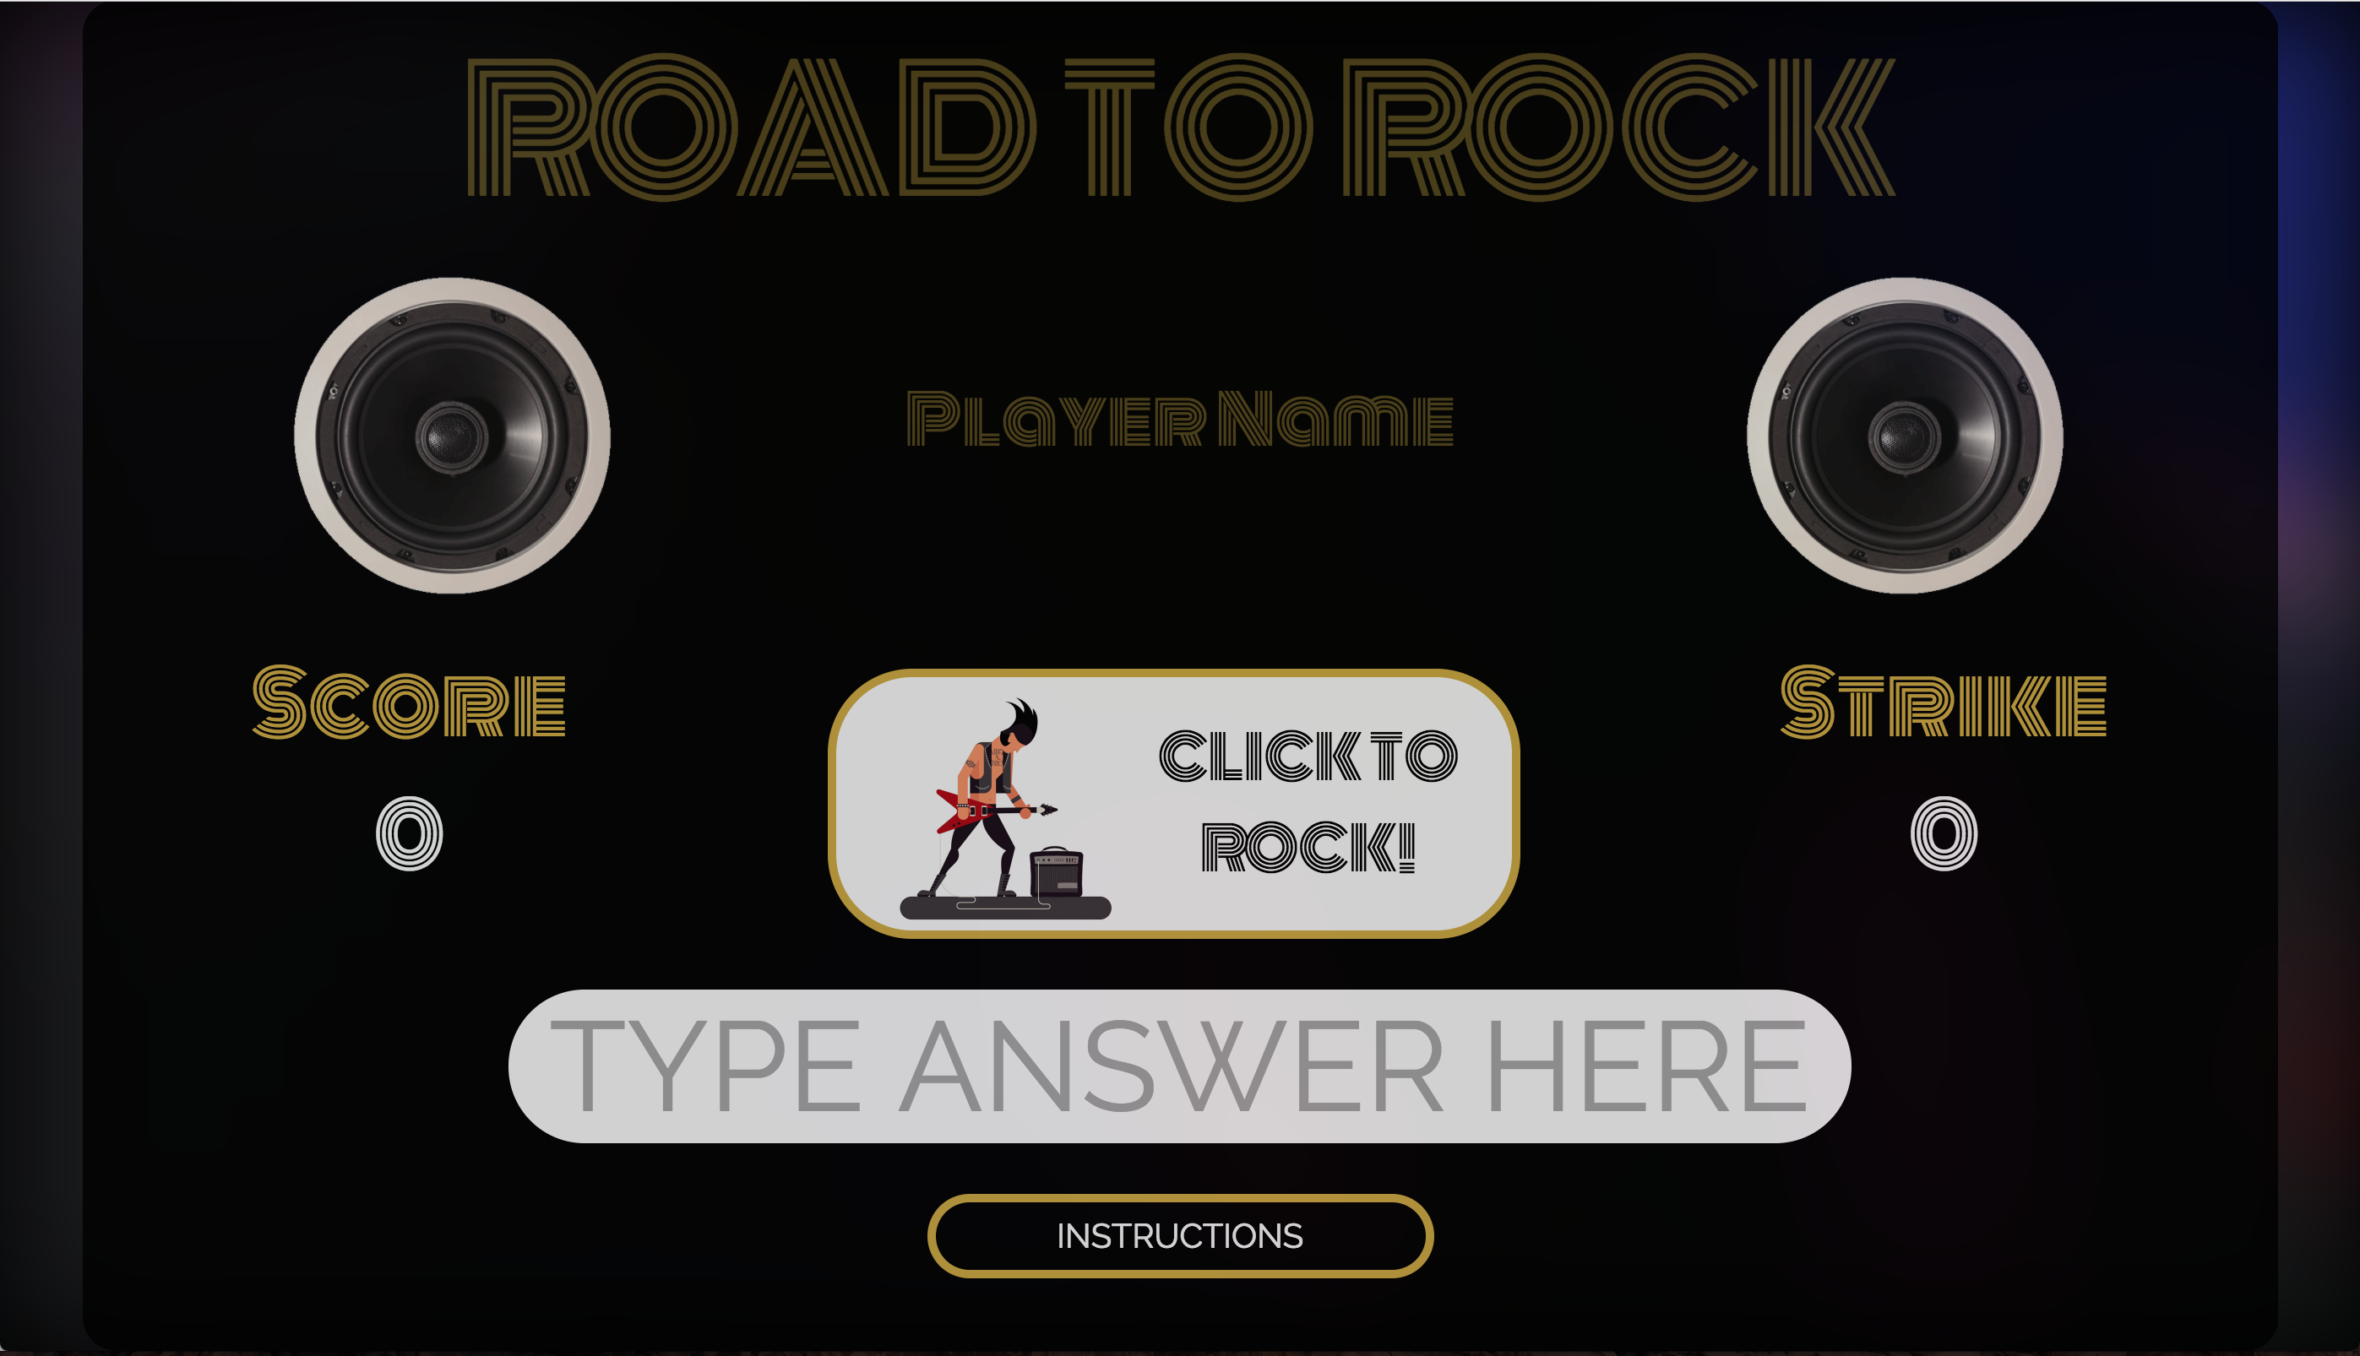
Game Screenshots
LANDING PAGE
GAME PAGE

Slide 8
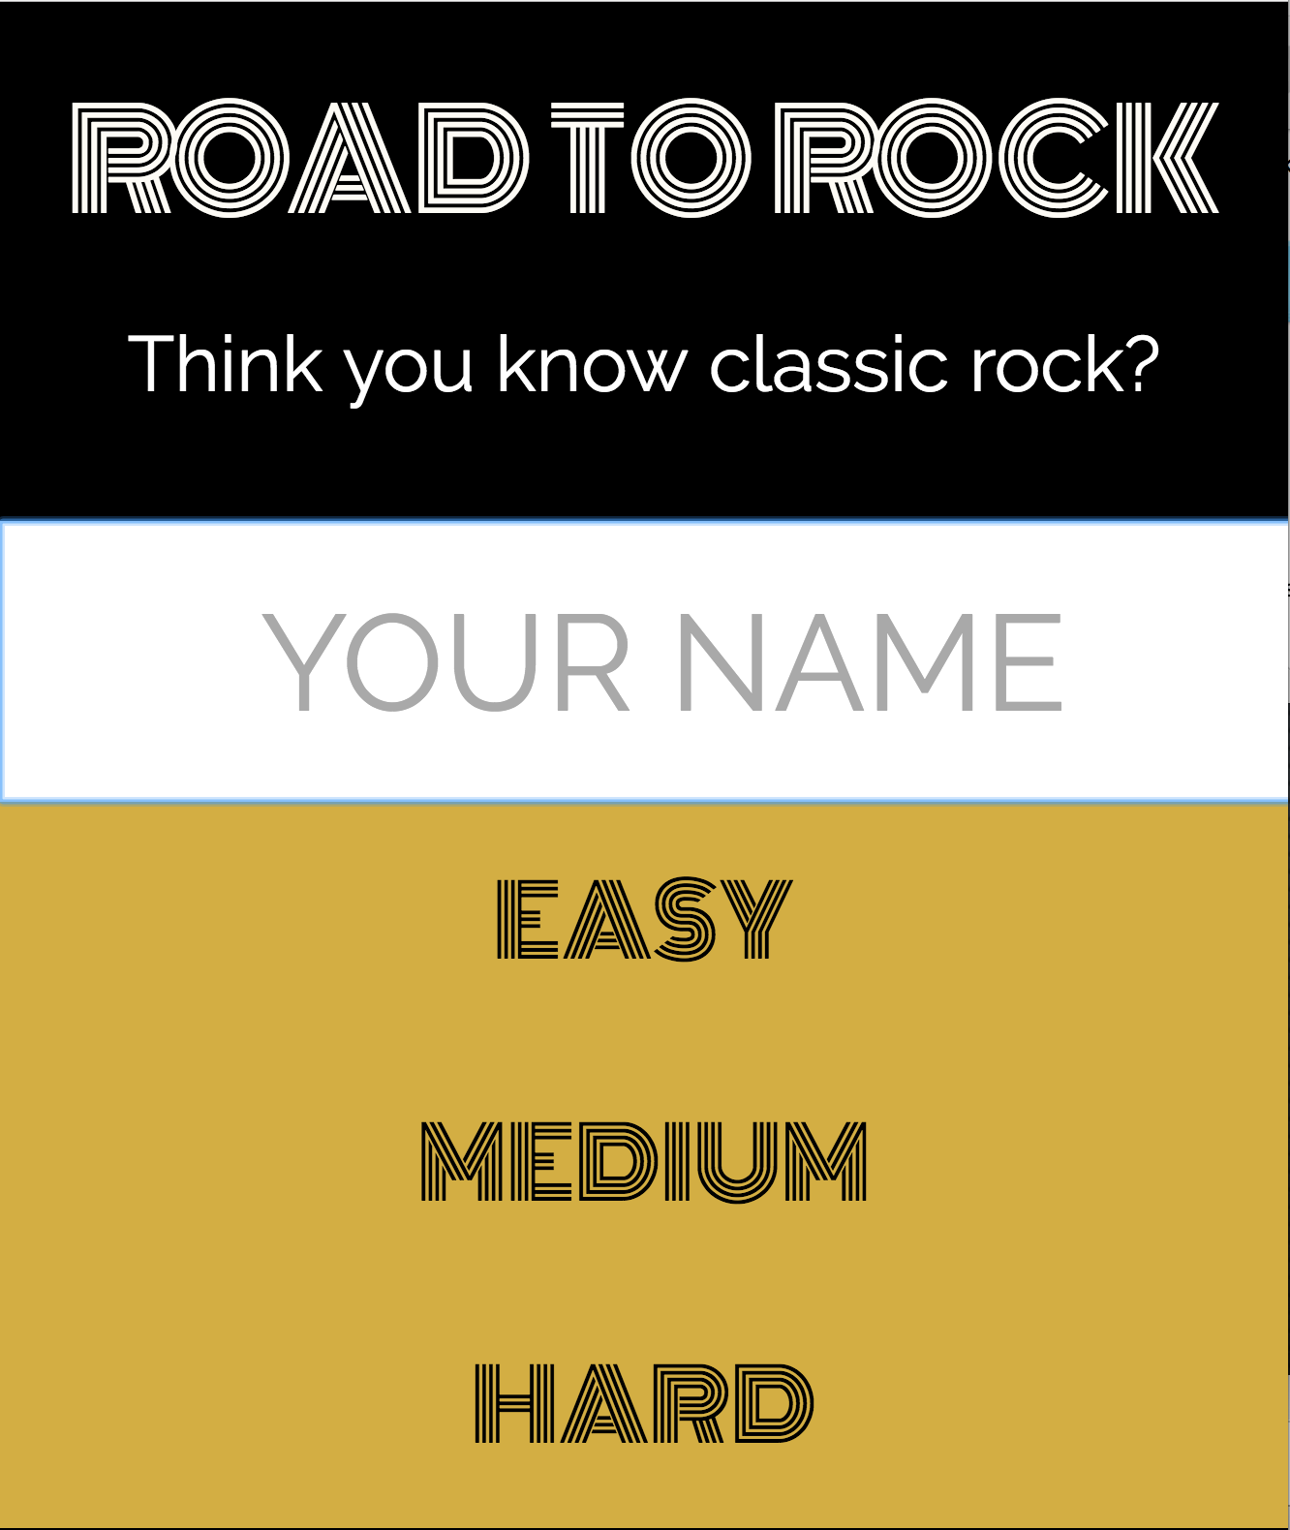
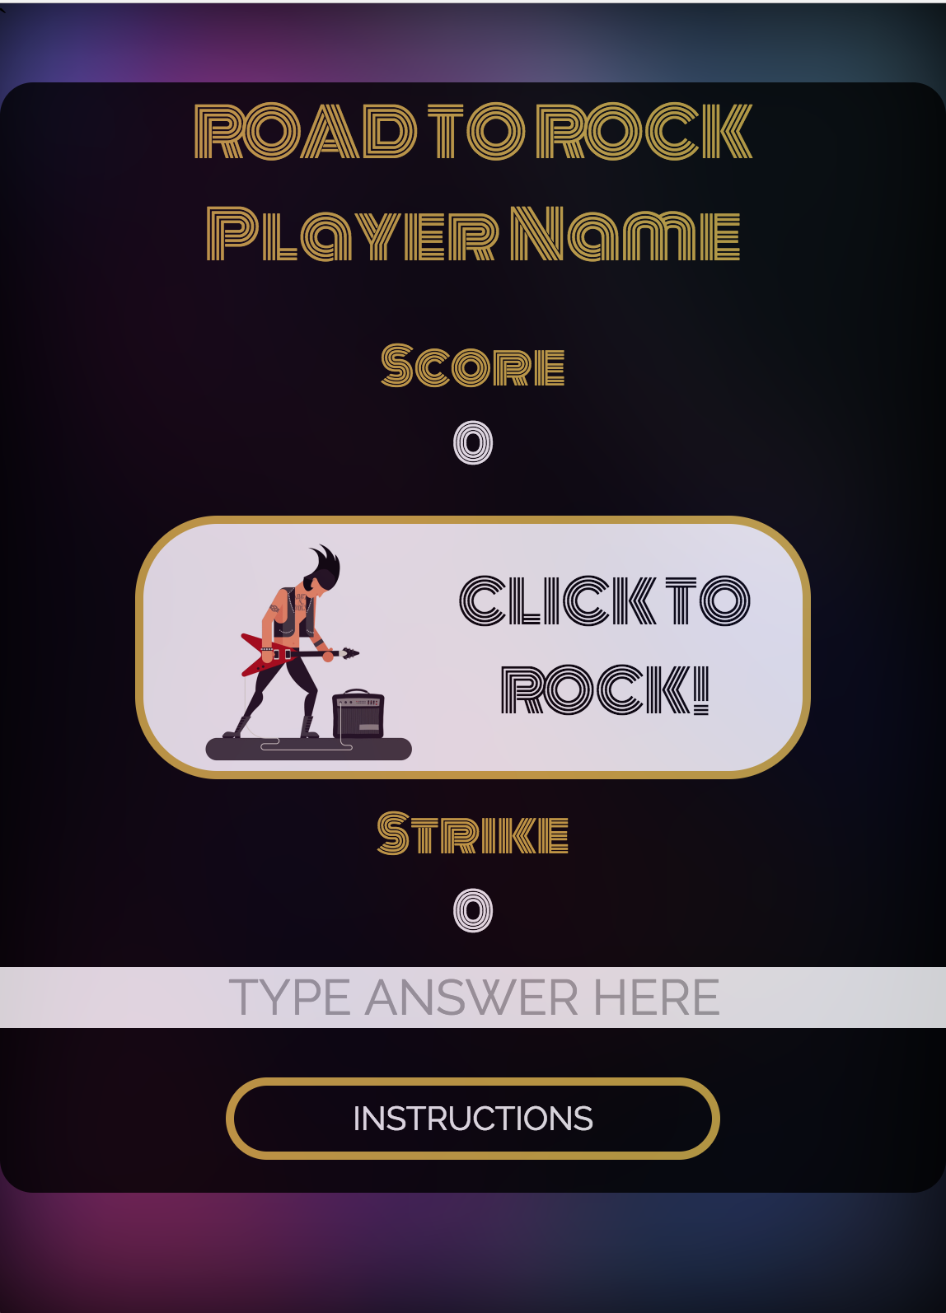
MOBILE Game Screenshots
LANDING PAGE
GAME PAGE

